Slide 1
Exercise Classification using Smart Watch Data
and supervised Learning
Pascal Luc & Patrick Vagenknecht

Slide 2
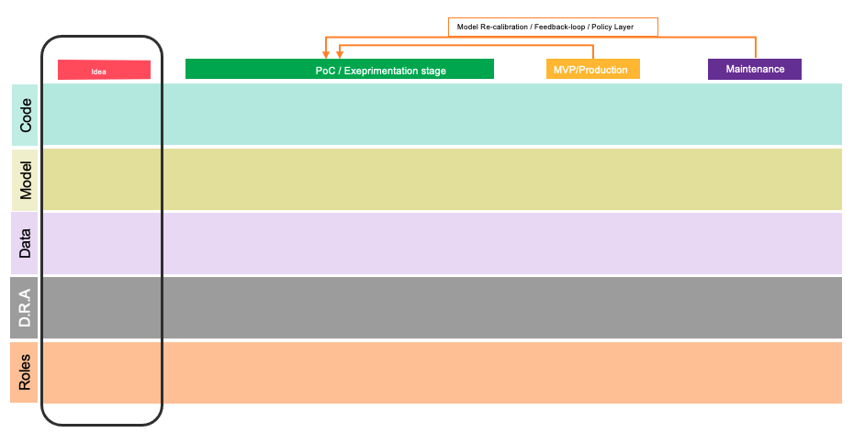
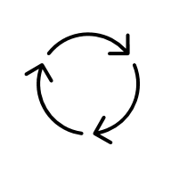
Idea canvas – Complete MLOps canvas
Use-case – Resistance Training Exercise Recognition based on Smart / Fitness Watch Information
Benefits – Consistency checks and appropriate intensity adjustment
Review prediction and Note down erroneous results
Validate according user feedbacks
Plausibility checks
Ommited notetaking:
Progresstracking without distraction.
Full concentration on excecution, objective and accurate intensity representation
Immediate (audio) feedback
Judgement
Target = Predict faults
Adjust intensity with Additional / Less Weights / Repetitions
-Exercise Type
-Amount of Repetitions / duration of set
-Pause in between Sets (and other Anomalies)
-Goals for next workout
Prediction
Action
Value
Input
Heart Beat Per Minute
Exercise Type
Repetitions
Weight
(Gyro Data, X, Y, Z, angular velocity of handwrist)
Adjust Model according to the constitution of individuals
(mood, prev workout performance, ground heart beat rate, sleep)
Lower or higher threshold / strictness of completion set goals (to be able to move to next stage)
User Input / Corrections (type, repetitions, weights)
Injuries
Overexhaustion (unfit for next workout)
Early cancelation of sets
Less improvement (intensity too low)
Wasted Time (Junk Volumes)
Training
Feedback
Notes:
One imporant aspect of such a framework is who the end-user is? i.e. the person who makes the judgement

Slide 3
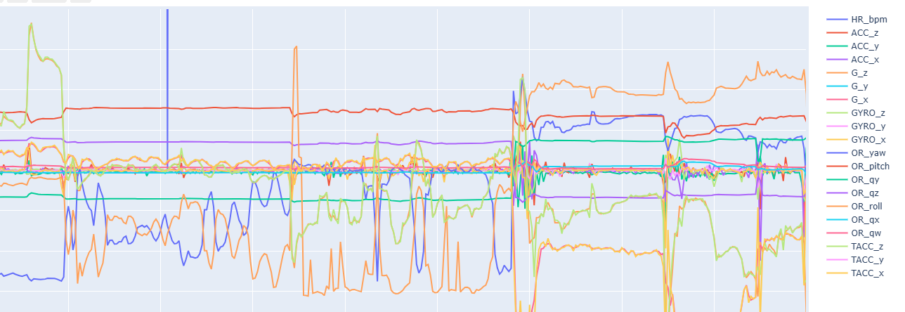
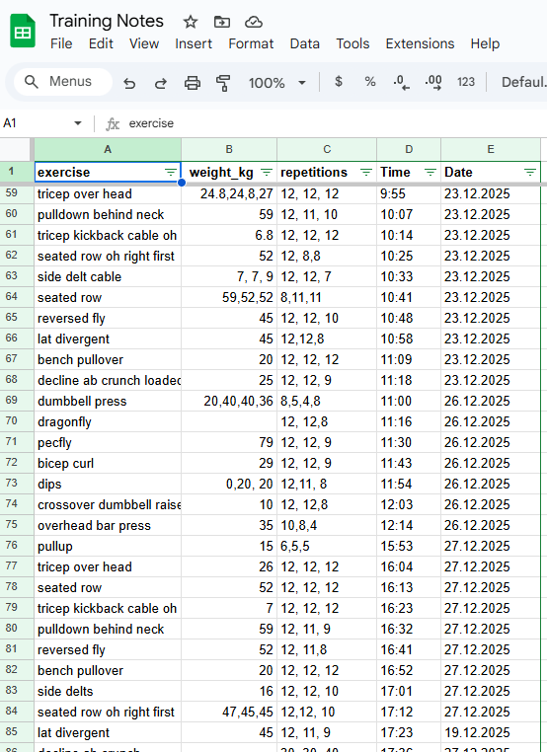
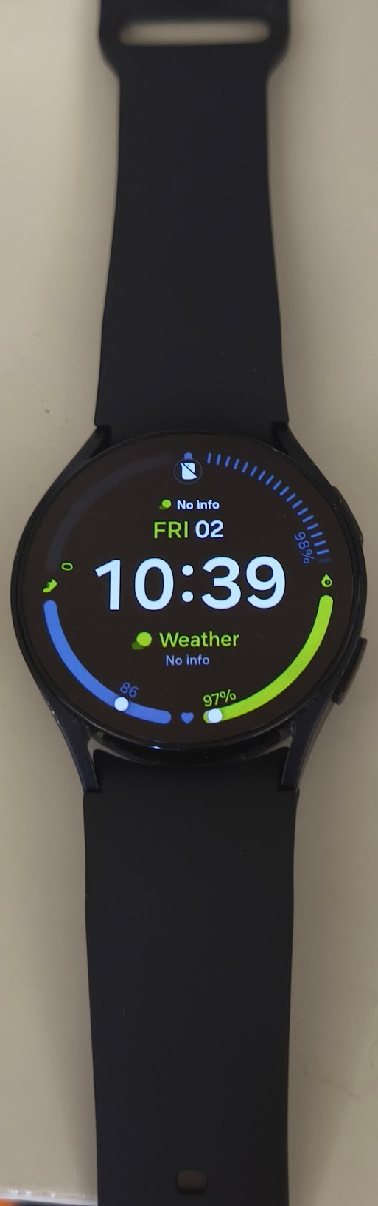

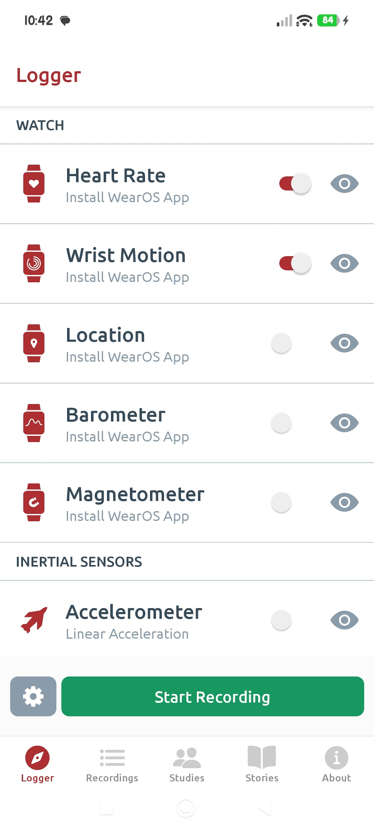


Dataflow
1. Sensor Data:
2. Annotations: Google Sheets
bluetooth
Extract and upload CSV
Download

Slide 4
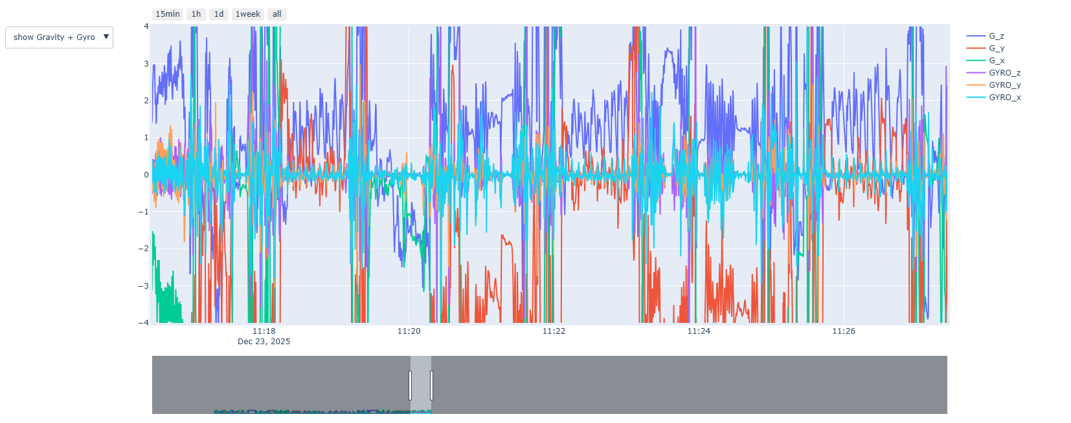
EDA

Slide 5
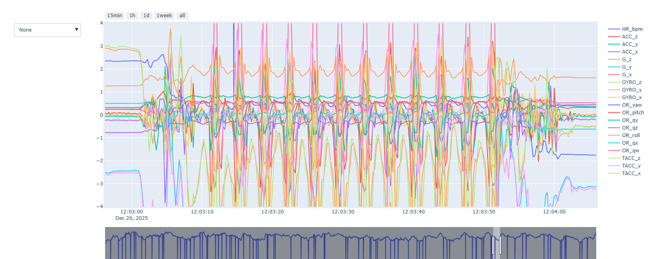
EDA example: Crossover dumbbell raise

Slide 6
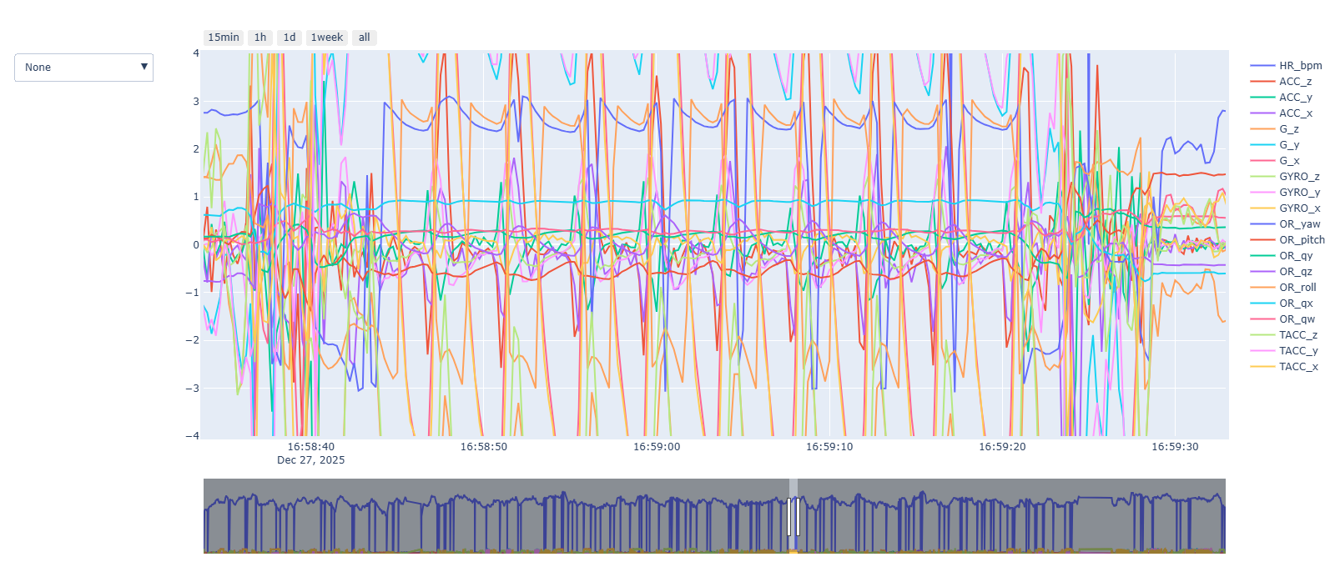
EDA Example: Bench pullover

Slide 7
ML Pipeline (+lessons learned)
Preprocessing
Feature Engineering
Modelling
Resample: 250ms / 4 Hz (vs 20Hz)
Due to different sampling rate
Interpolate with Polynomial function
Battery Drainage
Balancing: 92 samples / Exercise
Due to differences in the exercise duration
Time Span Labeling: From annotated minute to exact second of exercise execution
*Initially 1 second ahead of the actual exercise (not working with classic ML)
5s Window, 2.5s shift:
Mean
Std
FFT.Freq
Peaks & Valleys
PCA Result with 3 components:
Initially Low variance ratio: <51%
16 PCs to explain 90% of variance
BaggingClassifier
SVC
Decision Tree
RandomForest
Limited computing power
Limited Data
(Boosting: prone to overfit the data)

Slide 8
Bagging Classifier (Ensemble Method)
Train Test Split
Standardization Train data
SVC
Decision Tree
Random Forest
Estimator 1…n
Train with Bag (Bootstrapped Train Data) 1…n
Majority Voting
Estimator 1…n
Train with Bag (Bootstrapped Train Data) 1…n
Predict same Test Data with all 1-n Estimators
Estimator 1…n
Train with Bag (Bootstrapped Train Data) 1…n
Predict same Test Data with
all 1-n Estimators
Predict same Test Data with
all 1-n Estimators
Majority Voting
Majority Voting

Slide 9
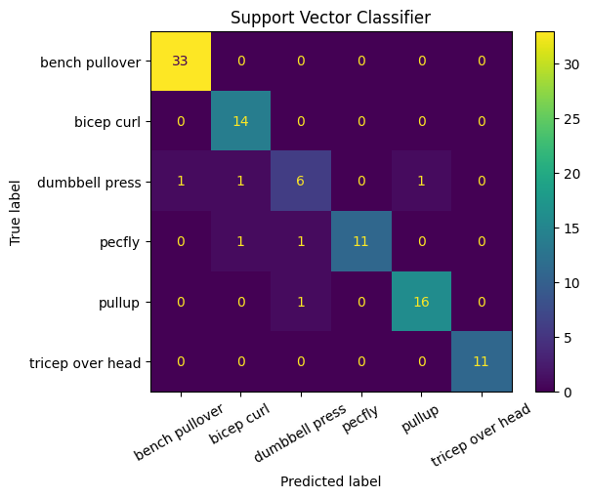
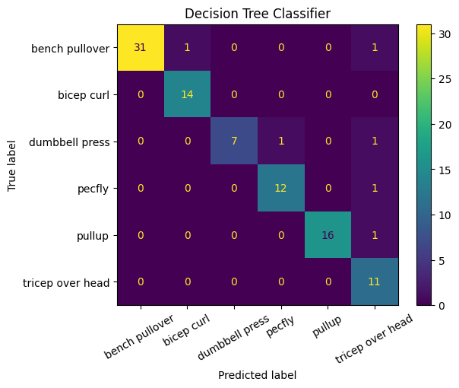

Is this possible?
93.8%
Score: 93.8%
Score: 93.8%
Data: 5 different non-similar exercises
No Scaling
Input Vectors: Raw Features (mean,std)
Window 5s, Shift 5s
Score: 94.8%

Slide 10
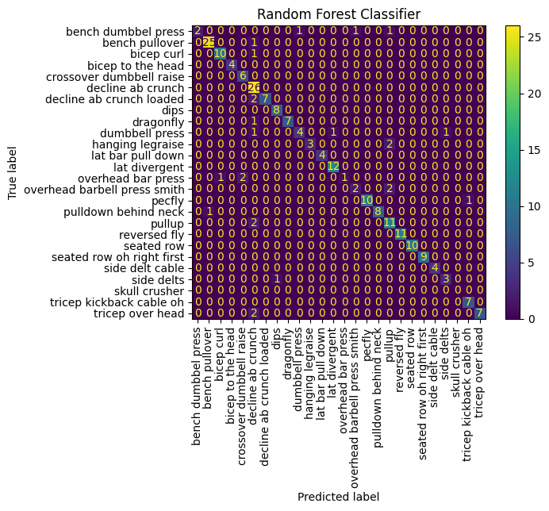
Random Forest best in Baseline (with all classes ~23)
precision recall f1-score support
accuracy 0.889381 0.889381 0.889381 0.889381
macro avg 0.917359 0.840670 0.857841 226.000000
weighted avg 0.906172 0.889381 0.883704 226.000000
All 26 exercises
PC Space
Downsampling of Majority Classes

Slide 11
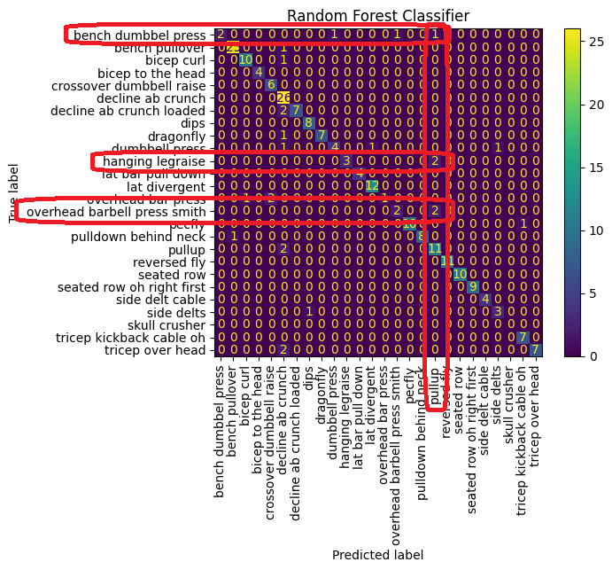
Insights
While numerous exercises exhibit comparable movement patterns, the features derived from the precise smartwatch data provided sufficient variation to distinguish between them. Additionally, exercises that were initially considered difficult to identify, due to near stationary hand positions and therefore prone to be masked by noises, such as the dragonfly, dips and pull-up, were successfully classified with modern highly sensitive IMUs. As for other exercises, the most distinguishing variable was the watch orientation.

Slide 12
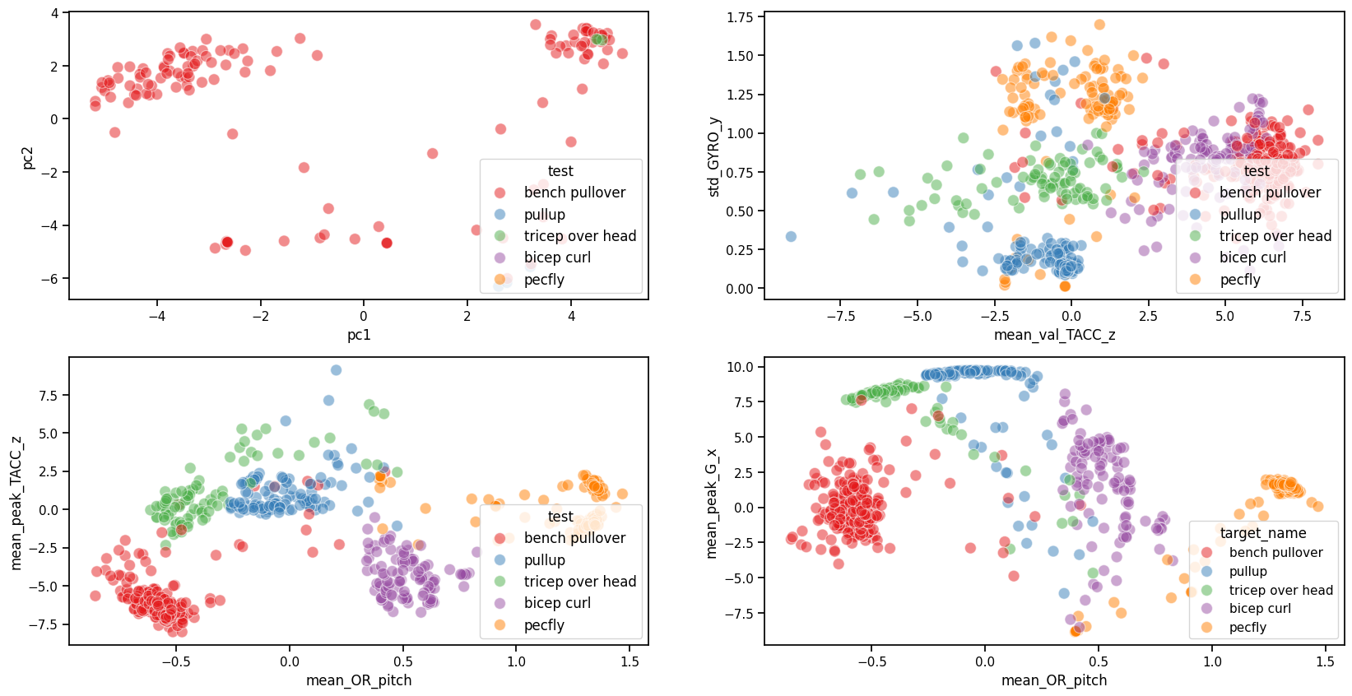
3rd Iteration + engineered Features (mean peaks & valleys)

Slide 13
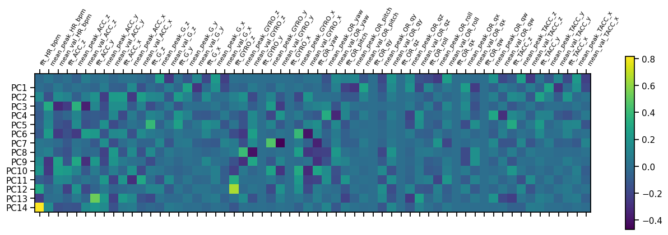
PCA .9

Slide 14
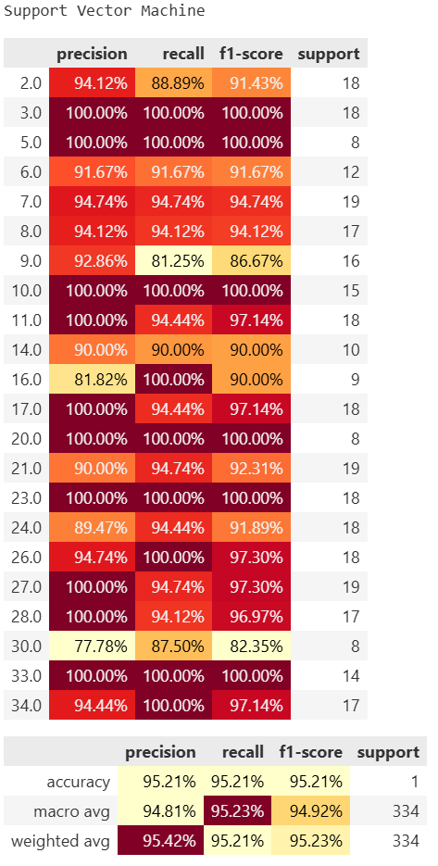
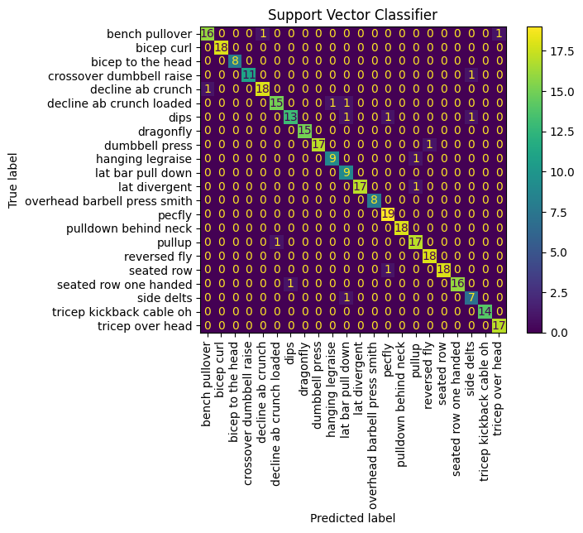
SVM is the chosen model
All 26 exercises
Feature Space
Stratify
5s Window, 2.5s Shift

Slide 15
Cross Validation
GridSearch to find the best SVC Hyperparameters
Optimize for Score Metric: Precision
Fixed: class weights=“balanced”
Search: Kernel, C, Gamma
Twist and turns with PCA
Feature Space Accuracy Score: 0.96
Principal Component Space Accuracy Score: 0.95

Slide 16
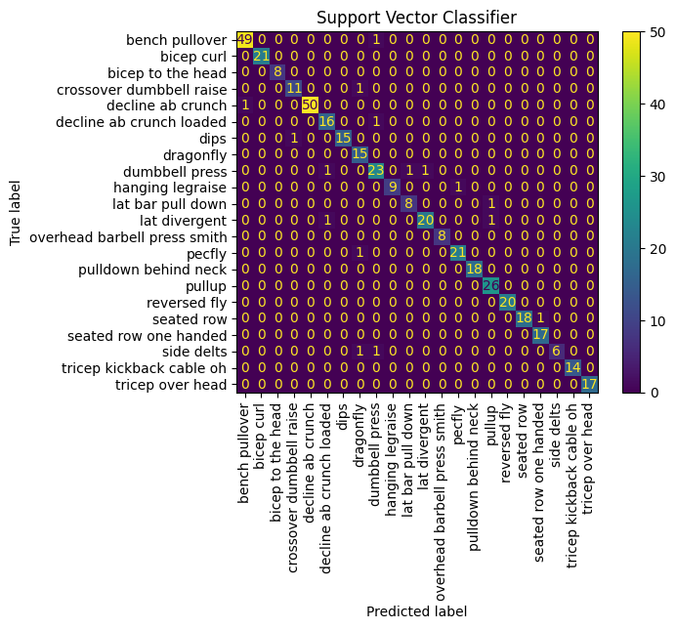

Final Model Result
Best parameters (with 96% precision weighted by support):
Kernel=RBF, C=80, Gamma=0.001
GridSearchCV: our Hero!

Slide 17
Overfitted / Sample Size Issues….
Mean of 5 Test Holdout x 10 Folded Train Data CV scores
precision weighted train: 1.00
precision weighted test: 0.89

Slide 18
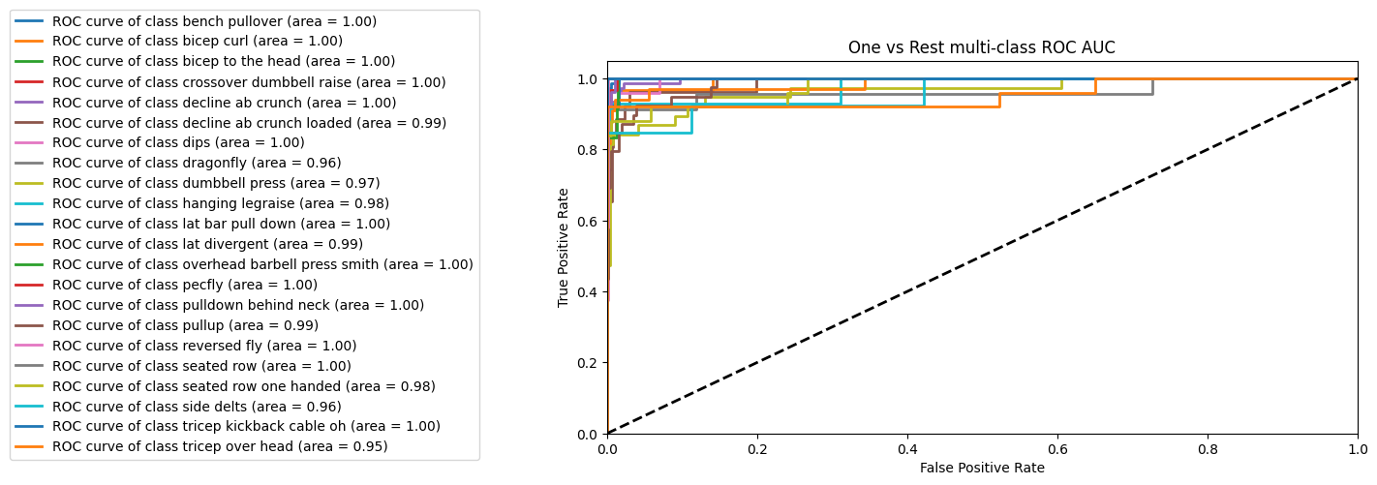
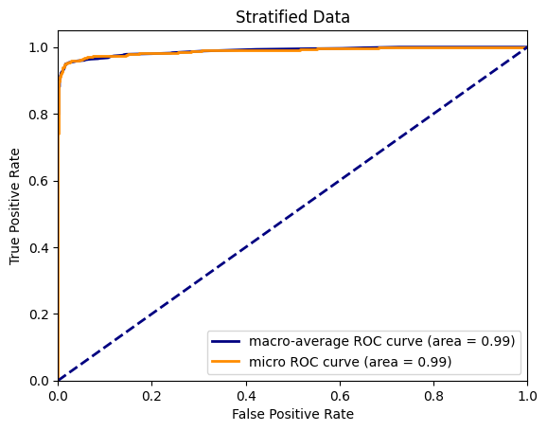
ROC AUC
Lessons learned: OneVsRest doesn’t work with SVC Kernel=RBF

Slide 19
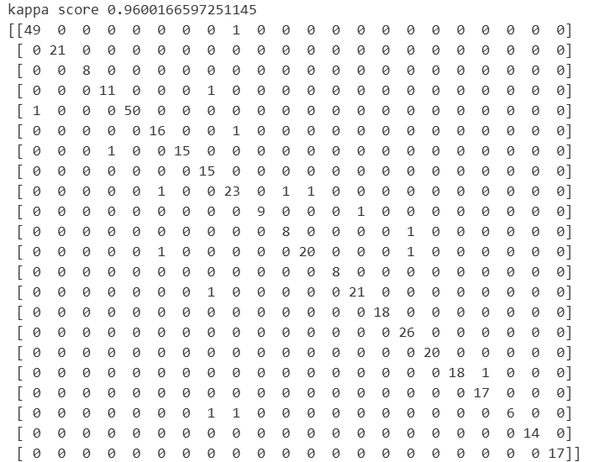
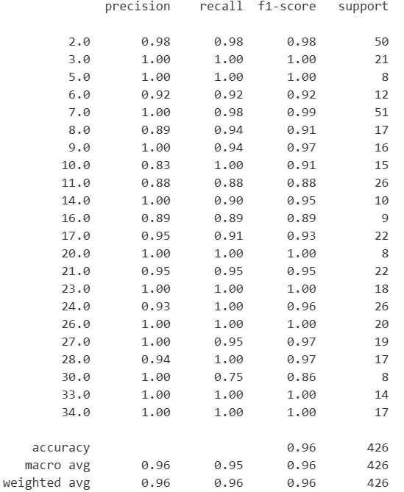
kappa score 0.96

Slide 20
Reference
https://journals.sagepub.com/doi/pdf/10.1177/0020294018813692

